Slide 1


Hate crimes
Marlene Aviles
680: Applied DATA SCIENCE

Slide 2
OVERVIEW
DEFINITION OF THE TERM
STATISTICS
ISSUE & IMPORTANCE
PROJECT GOAL
DATA SOURCE
DATASET
DATA PREPARATION
EXPLORATORY DATA ANALYSIS
EDA: DISTRIBUTION
EDA: CORRELATION MATRIX
MULTIPLE LINEAR REGRESSION ANALYSIS
FINDINGS
LIMITATIONS
CONCLUSION
COMMENTS OR QUESTIONS
SOURCES CITED

Slide 3
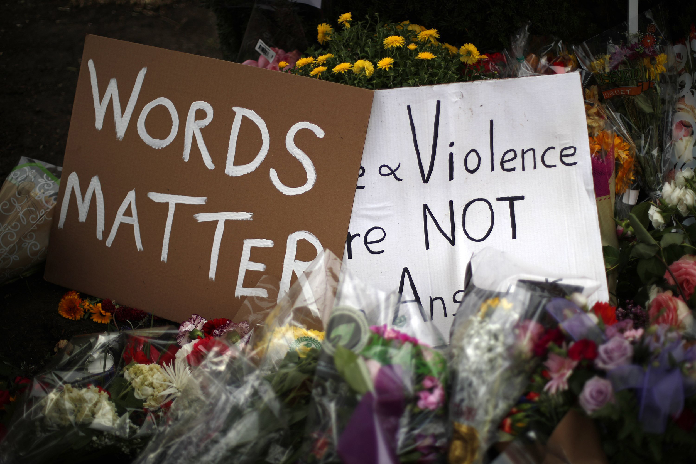
Hate crime
A criminal offense against a person or property which is motivated in whole or part by an offender’s bias against a race, religion, disability, sexual orientation, ethnicity, gender, or gender identity

Slide 4
Statistics
AT LEAST
8 BLACK PEOPLE,
3 WHITE PEOPLE,
3 GAY PEOPLE,
3 JEWISH PEOPLE, AND
1 LATINX PERSON BECOME HATE CRIME VICTIMS EVERY DAY.
- “WWW.DOSOMETHING.ORG”
EVERY HOUR IN THE U.S. SOMEBODY COMMITS A HATE CRIME
EACH YEAR ALONE ABOUT 205,000 PEOPLE ARE VICTIMIZED BY HATE CRIMES ACROSS THE U.S.

Slide 5
ISSUE & importance
BEING ABLE TO IDENTIFY DETERMINANTS TO HATE CRIMES IS BENEFICIAL TO SOCIETY AS A WHOLE
HATE CRIMES IS AN IMPORTANT COMMUNITY ISSUE THAT AFFECTS ALL OF US (INDIVIDUALLY, CITY-WIDE, NATION-WIDE)
THE MEDIA HAS TALKED ABOUT AN INCREASE IN HATE CRIMES SINCE 2016
DOES THE DATA COLLECTED ON HATE CRIMES REFLECT THE SAME NOTION?

Slide 6
Project goal
THE FIGHT AGAINST HATE CRIMES IS ONE THAT WILL ONLY BECOME MORE EFFICIENT AND REPRESENTATIVE VIA ITS ANALYSIS OF DATA
THE AIM OF THIS PROJECT IS TO LOOK AT FACTORS THAT CAN HELP IN IDENTIFYING THE DETERMINANTS OF HATE CRIMES.
TECHNIQUES SUCH AS EXPLORATORY DATA ANALYSIS AND REGRESSION ANALYSIS ASSISTED IN ACHIEVING THIS GOAL

Slide 7
Data SOURCE
THE DATA UTILIZED FOR THIS ANALYSIS WAS EXTRACTED FROM FIVETHIRTYEIGHT
FIVETHIRTYEIGHT IS A WEBSITE FOCUSED ON STATISTICAL ANALYSIS ABOUT POLITICS, ECONICS, AND MORE THROUGH THE USE OF DATA
GITHUB LINK:
https://github.com/fivethirtyeight/data/blob/master/hate-crimes/README.md

Slide 8
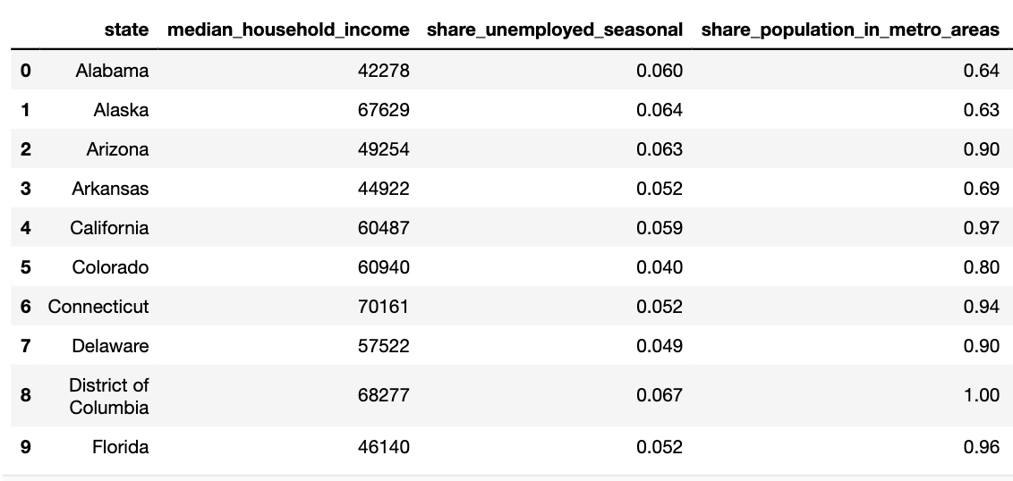
DATASET
51 ROWS AND 21 COLUMNS
ROWS CONTAIN DATA FROM EACH U.S. STATE
COLUMNS REPRESENT THE DIFFERENT VARIABLES
DATA WAS GATHERED IN 2016
VARIABLES IN THE DATASET:
State: State name
Median_household_income: Median household income, 2016
Share_unemployed_seasonal: Share of the population that is unemployed, 2016
Share_population_in_metro_areas: Share of the population that lives in metropolitan areas, 2015
Share_population_with_high_school_degree: Share of adults 25 and older with a high-school degree, 2009
Share_non_citizen: Share of the population that are not U.S. citizens, 2015
Share_white_poverty: Share of white residents who are living in poverty, 2015
Gini_index: Gini index, 2015
Share_non_white: Share of the population that is not white, 2015
Share_voters_voted_trump: Share of 2016 U.S. presidential voters who voted for Donald Trump
Hate_crimes_per_100k_splc: Hate crimes per 100,000 population by the Southern Poverty Law Center (Nov 9-18, 2016)
Avg_hatecrimes_per_100k_fbi: Average annual hate crimes per 100,000 population, FBI 2010- 2015

Slide 9

Data preparation
CONVERTED INTO A PANDAS DATAFRAME
ANALYZED SUMMARY STATISTICS
LOOKED FOR MISSING VALUES
LOOKED FOR OUTLIERS
LOOKED FOR DUPLICATES
LOOKED FOR ERRORS IN THE DATA

Slide 10
Exploratory data analysis: (eda)
HELPS GAIN A DEEPER UNDERSTANDING OF THE DATA AND ITS TRENDS AND PATTERNS
EXECUTES VISUALS THAT WILL HELP LOOK AT RELATIONSHIPS BETWEEN THE VARIABLES AND THEIR DISTRIBUTIONS

Slide 11
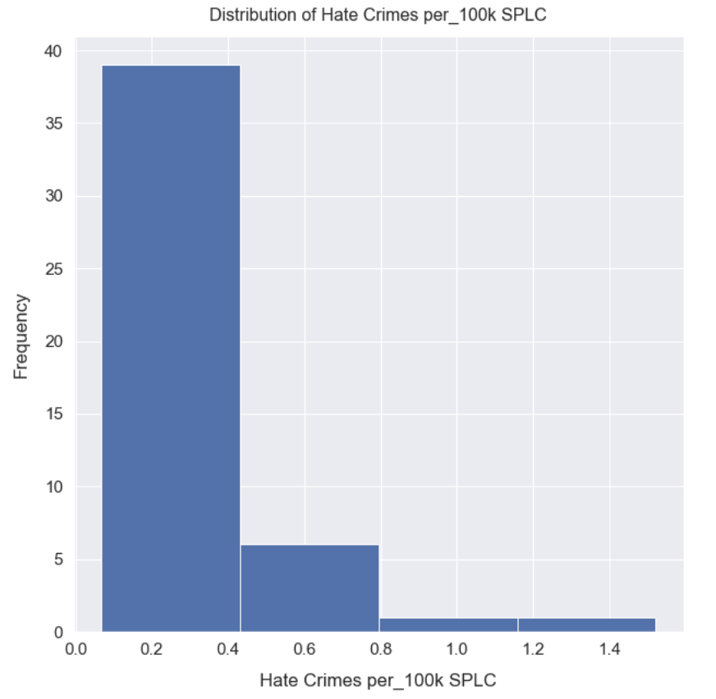
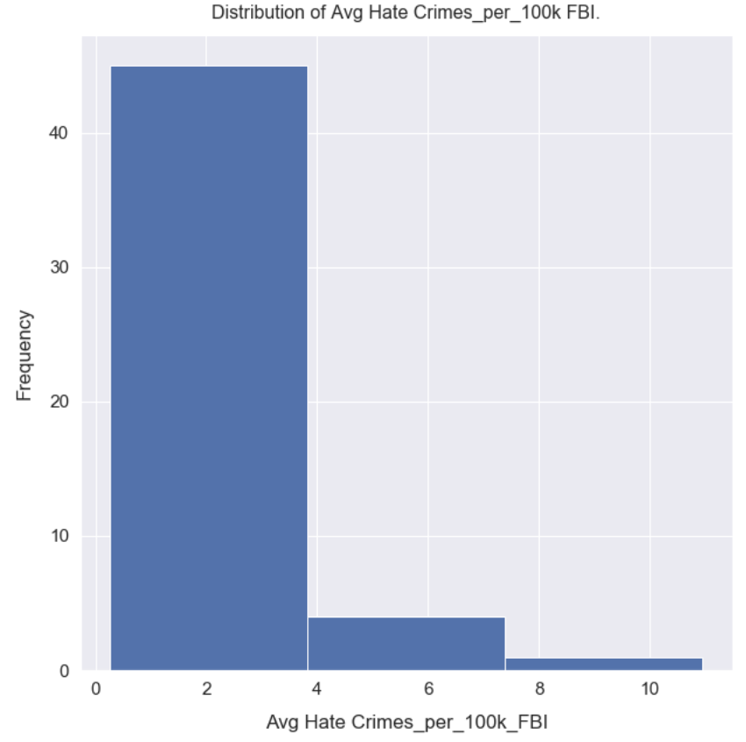
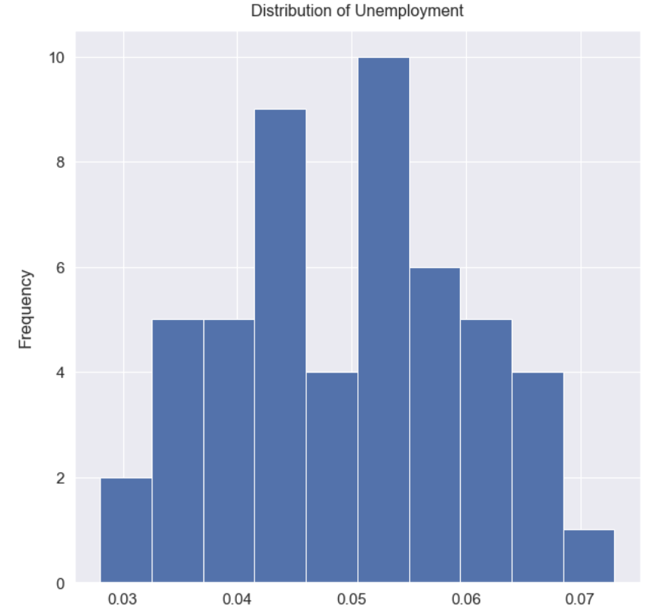
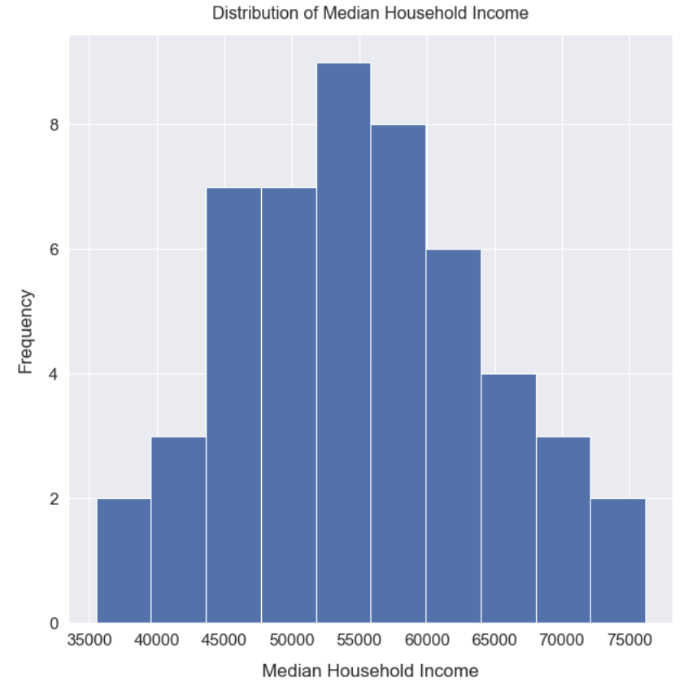
EDA: distribution
THE TWO HATE CRIME VARIABLES, SIMILAR DISTRIBUTIONS
UNEMPLOYMENT WAS TWO PEAKS, BIMODIAL DISTRIBUTION
MEDIAN HOUSEHOLD INCOME, NORMAL DISTRIBUTION

Slide 12
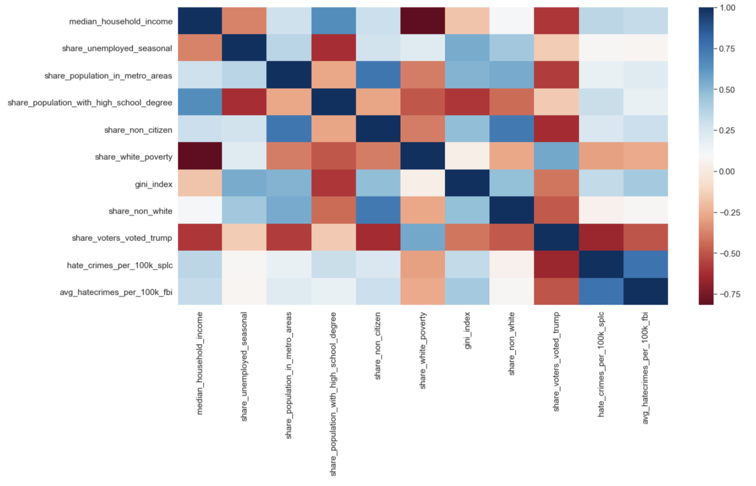
Eda: correlation MATRIX

Slide 13
MULTIPLE LINEAR REGRESSION ANALYSIS
METHOD SELECTED GIVE IT CAN BE APPLIED ON REAL-LIFE SCENARIO
FINDS OUT WHICH FACTOR HAS THE HIGHEST IMPACT ON THE PREDICTED OUTPUT, AND HOW DIFFERENT VARAIBLES RELATE TO EACH OTHER
PREDICTED OUTPUT:
hate_crimes_per_100k_splc

Slide 14
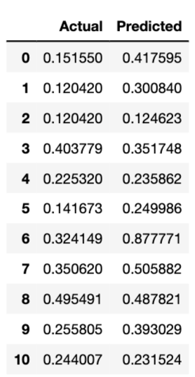
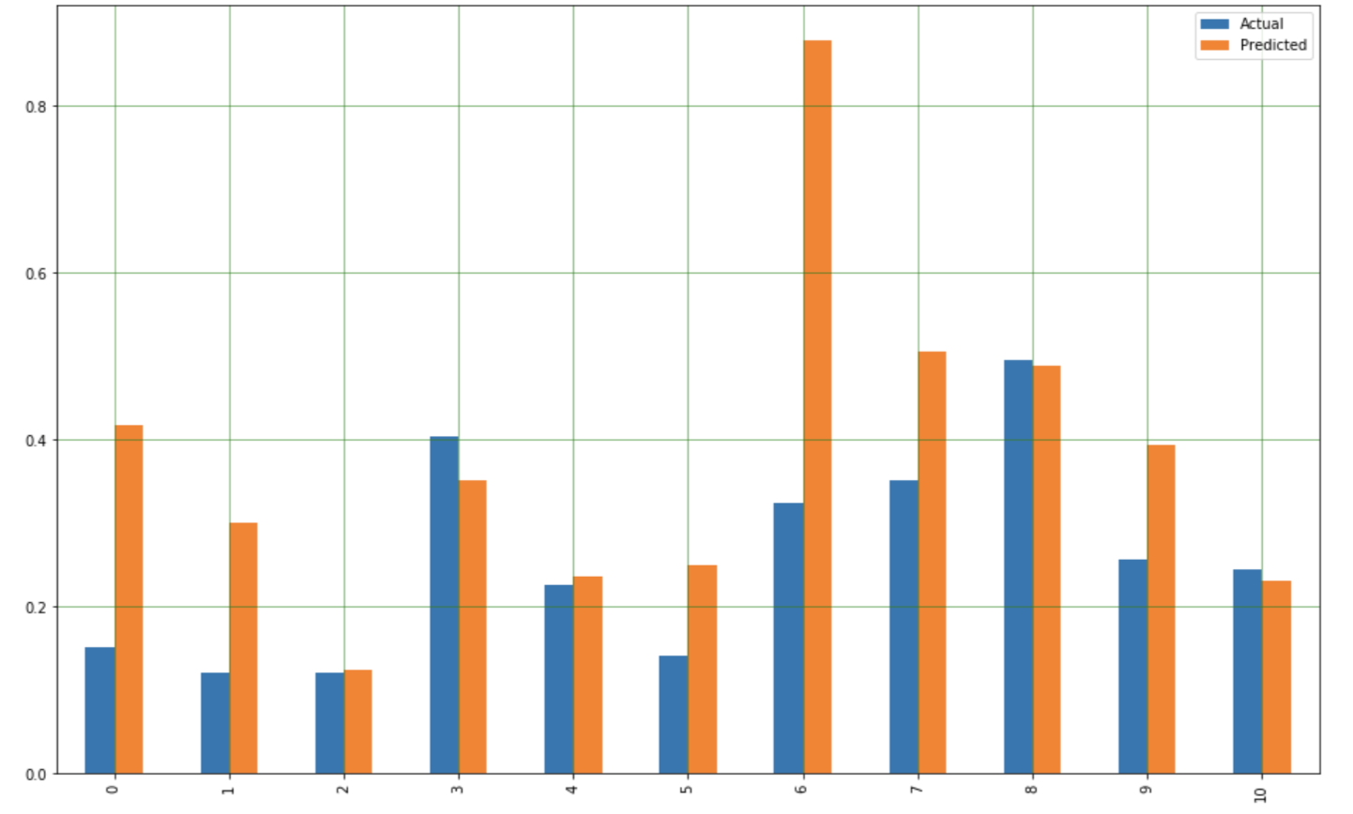
FINDINGS
MAE Mean Absolute Error: 0.13525585604976
MSE Mean Squared Error: 0.04250436779614115
RMSE Root Mean Squared Error: 0.2061658744703913

Slide 15

LIMITATIONS
IT IS SIGNIFICANT TO REMARK THAT LIMITATIONS WERE RECOGNIZED DURING THIS PROJECT
THE AMOUNT OF DATA AVAILABLE ON THIS SUBJECT IS SHORT
THIS LIMITATION SHEDS A LIGHT INTO ANOTHER ASPECT OF THE MAIN PROBLEM: HATE CRIMES AND THE WAY THEIR DATA IS GATHERED

Slide 16
CONCLUSION
HATE CRIMES AND THE DETERMINANTS OF THIS DATASET WERE NOT NOTABLE ENOUGH TO PRECISELY PREDICT THE TARGET VARIABLE
THE VARIABLES HAD VERY LOW AND NON-SIGNIFICANT CORRELATIONS TO THE TARGET VARIABLE
HATE CRIMES CONTINUE TO BE A PROBLEM IN THE U.S., AND A MORE BENEFICIAL APPROACH IN THE COLLECTION OF HATE CRIME DATA NEEDS TO EXERTED
THE INCREASE IN DATA COLLECTION ADVOCATES IN MAINTAINING A TOLERANT AND DIVERSE SOCIETY WHICH WILL HELP IN THE REDUCTION OF HATE CRIMES

Slide 17
COMMENTSOR QUESTIONS
EMAIL:
MAVILES@MY365.BELLEVUE.EDU
Thank you!

Slide 18
Sources cITED:
BBC. (2017, November 13). FBI: US hate crimes rise for second straight year. https://www.bbc.com/news/world-us-canada-41975573
Federal Bureau of Investigation (n.d.). Hate Crimes. Retrieved June 20, 2020, from https://ucr.fbi.gov/hate-crime
Figure 1. Retrieved from https://www.nbcnews.com/feature/nbc-out/anti-lgbtq-hate-crimes-rose-3-percent-17-fbi-finds-n936166
Figure 2. Retrieved from https://www.karmelsoft.com/data-collection-tactics-for-web-administrators/
FiveThirtyEight. (2017). Hate Crimes. [Data set].https://github.com/fivethirtyeight/data/blob/master/hate-crimes/README.md
Kaiser Family Foundation data on Median Annual Income in the U.S. Retrieved from https://www.kff.org/other/state-indicator/median-annual-income/
Kaiser Family Foundation data on race and ethnicity distribution in the U.S. Retrieved from https://www.kff.org/other/state-indicator/distribution-by-raceethnicity/?currentTimeframe=0&sortModel=%7B%22colId%22:%22Location%22,%22sort%22:%22asc%22%7D
Kaiser Family Foundation data on unemployment rate (seasonally adjusted) in the U.S. Retrieved from https://www.kff.org/other/state-indicator/unemployment-rate/?currentTimeframe=0&sortModel=%7B%22colId%22:%22Location%22,%22sort%22:%22asc%22%7D
Majumder, M. (2017, Jan 23). Higher rates of hate crimes are tied to income inequality. FiveThirtyEight. https://fivethirtyeight.com/features/higher-rates-of-hate-crimes-are-tied-to-income-inequality/
SPLC Southern Poverty Law Center. (2018). Hate Crimes: explained. Retrieved June 20, 2020, from https://www.splcenter.org/20180415/hate-crimes-explained
SPLC Southern Poverty Law Center (n.d.). What we do. Retrieved June 20, 2020, from https://www.splcenter.org/what-we-do
United States Census Bureau. (2010, Feb). United States Census data on educational attainments. Retrieved from https://www.census.gov/prod/2012pubs/p20-566.pdf
United States Election Projects data on 2016 election turnout. Retrieved from http://www.electproject.org/2016g

